Slide 1
Accessibility of AI Tools
Luke McKnight, Assistive Technologist
Notes:
Hi, my name is Luke McKnight. I am the assistive technologist at Langara College. I work with students, staff, and faculty using assistive technology to access Langara’s digital spaces.
In July 2023 after various conversations with colleagues about the lack of discussion regarding the accessibility of all these AI tools we’d been scrambling to figure out, I decided to do some testing. As far as I can tell, no one else has.

Slide 2
Outline
AI Tools
FAST
Concerns
Accessible AI
Notes:
This is a brief session, so I am going to introduce some top-level stuff, talk about my testing and why it matters, then direct you to further resources. We can talk more later if you’re interested.

Slide 3
Artificial Intelligence
Bard
Bing.com Chat
Bing Discover AI
ChatGPT 4
Claude
Dall-E
Perplexity
Pi.AI
Riff bot
Notes:
Not the AI itself, but the interfaces. I don’t think anyone, including the devs, know what goes on inside the AI blackbox. What I mean are the chatbots and generative Ais that have sprung up since Fall 22 and ChatGPT’s widespread release.
I’m sure we all know most of the names on this list. I put together my list of platforms to test based on conversation with EdTech colleagues, what we could get access to, and any that claimed to be more education focused.

Slide 4
Testing
FAST
Function
Appearance
Structure
Text Equivalents
Automated tests
+ assistive technology
Who’s excluded
Notes:
Accessibility
World Wide Web Consortium manages Web Content Accessibility Guidelines.
Most legislation, regulation built on those guidelines
Top level principles are Perceivable, Operable, Understandable, and Robust.
If I were completing an accessibility conformance report for these companies, I would use a voluntary product accessibility template aligned along those terms.
I don’t work for those companies and I want to do some practical testing. Unfortunately, sometimes accessibility tests forget to mention whether people using assistive technology can actually use the product.
I have FAST
Function, Appearance, Structure, and Text Equivalents.
Simply a different way to organize the testing that I feel is maybe easier to understand, and also answers the major question of who might be excluded.
Automated Testing
Code queries such as colour values, button labels, heading structure. Anything that does not meet requirements will be flagged.
Google devtools Lighthouse, WAVE from WebAim, ANDI
Manual testing
I note the automated flags then attempt to use the platforms with text to speech tools (ReadSpeaker), screen readers (JAWS, VoiceOver), magnifiers (ZoomText), keyboard navigation, and voice control (Dragon).
I do this to verify the automated tests because those tests miss a lot (only test about 25% of WCAG criteria) as well as flag false positives. Ultimately though, the assistive technology testing gives me an idea of whether the average user of said technology can interact with the platform I’m testing.
I take my findings and apply a rubric which gives me a score that equates to a level of concern. Greater concern means more students are likely to be excluded.

Slide 5
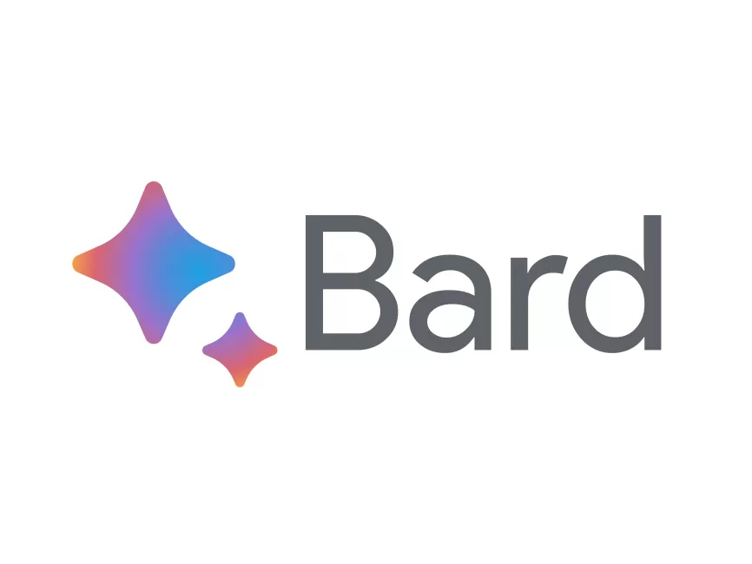
Concerns
Platform | Concerns
Bard | Minor
Bing Chat | Minor
Bing Discover | Moderate
ChatGPT | Moderate
Claude | Serious
Dall-E | Serious
Perplexity | Serious
Riff Bot | Serious
Pi.AI | Serious
Notes:
1 in 6 have a documented disability, but the total number of people with disabilities is certainly higher.
Accessibility is a big part of user experience for everyone, so the concerns I have affect the platforms total usability for everyone as well.
Most of the issues were very basic coding issues such as missing labels (which makes them invisible to screen readers and difficult to navigate to for someone using their voice), missing focus states, and contrast errors.
My assumption is that the rush to get these tools live meant little thought or care was put into good design and UX, let alone accessibility.
For the most famous of the AI chatbots, an hour with an admin could have it fully accessible.
So, if anyone knows somebody who knows somebody, let them know.
Some toward the bottom of the chart had much more egregious errors and would require significant rebuilds.
Based on my testing, a user of assistive technology should be able to effectively use Bard and Bing chat AI. Of course, Bard isn’t available in Canada yet, but I’m sure many of you could figure a way around that like I did.
ChatGPT and Bing Copilot/Discover/whatever they are calling it today that is built into the Edge Browser are ok and while technically accessible to assistive technology, I believe it would be functionally inaccessible to the average user of assistive technology.
The remainder had experience breaking errors that render them unusable by students that use assistive technology.

Slide 6
Going Forward
Notes:
I think we especially get excited when new technology arrives. We’re probably early adopters, we like to take the toys apart to find out how they work, push things to the limit and find out how we can use something and where.
But we need to consider how something new, especially something bleeding edge like AI might exclude some people. In this case, a lot of these tools aren’t going to work for some students. Let’s bring accessibility into our assessment of new tools and tools to be adopted. Whether it’s AI or an SRS or a collaborate tool we need to think about who we are leaving out.
And I have a whole spreadsheet of common courseware, AI interfaces, SRSs that are used but aren’t accessible. If anyone is interested, feel free to reach out.
So, let’s think hard about the tools we recommend.

Slide 7
Further Reading
Bit.ly/AIa11y
Accessibility of AI Interfaces
Building the world’s first accessible AI chat interface – U-M

