Slide 1
Increasing Accessibility for Video
Notes:
Kwantlen Richmond is on the ancestral unceded territory of the Musqueam, Katzie, Semiahmoo, Tsawwassen, Qayqayt, and Kwikwetlem, and with the lands of the Kwantlen First Nation, which gifted its name to this university.
UBC’s Vancouver Point Grey campus is situated on the traditional, ancestral, unceded territory of the Musqueam, Tsleil-Waututh, and Squamish peoples
disclaimer
This presentation is specifically about tools for accessibility in pre-recorded video
Accessibility / UDL includes diversity, representation, pedagogical design, live support of ASL etc – I’m not an expert in these
Other UBC resources regarding UDL considerations beyond scope of today’s presentation (links at end)
Equity & Inclusion office
Centre for Accessibility
Centre for Teaching, Learning and Technology
Thanks to Afsaneh Sharif of CTLT and Arthur Kremins and AC Deger of C for A for input and feedback

Slide 2
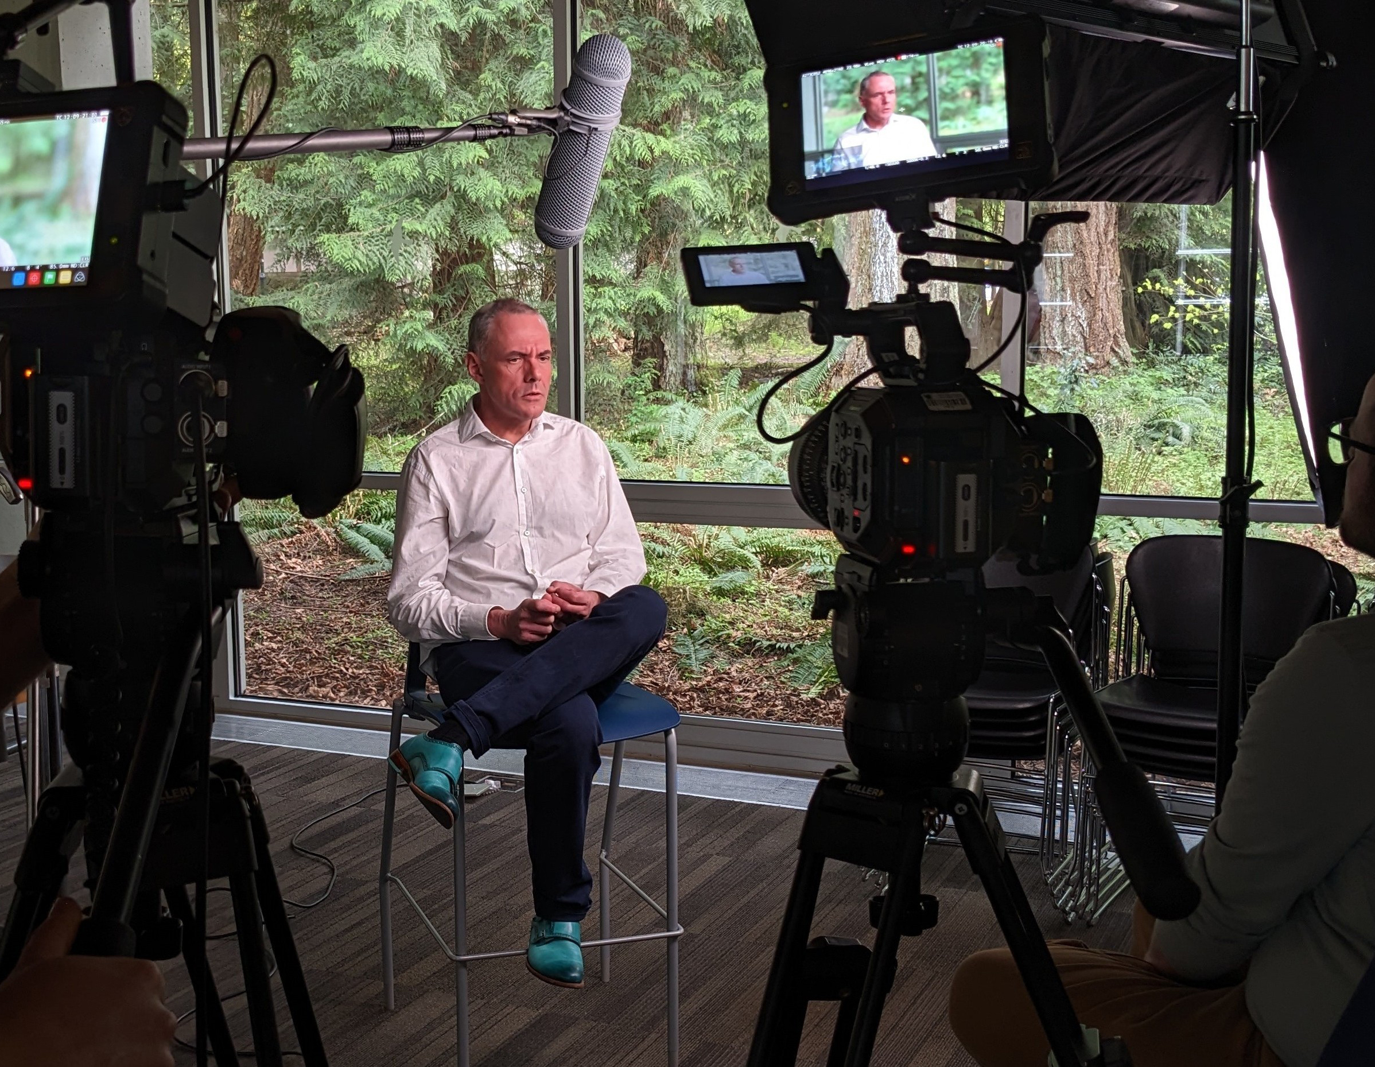
UBC Studios ubcstudios.ubc.ca
Media Consultation
Professional Media Production
video, motion graphics,
graphic design, photogrammetry,
virtual tours
Do-it-Yourself Studios
Workshops
Emerging Media Lab
Notes:
Central media production unit
We can’t make all fo the video
so in addition to high production quality we embrace DIY through
studios,
Workshops
consutlations

Slide 3
UDL - Universal Design in learning
A proactive approach to learning design
that allows us to recognize and accommodate
a diversity of learners
and reduce barriers to learning

Slide 4
UDL - Universal Design in learning
A proactive approach
build accessibility into your plan
instead of trying to retrofit for accessibility
Notes:
Results in more efficient process, and better production result
Example – build descriptive elements into script during planning instead of adding new narrator voice after which ahs to squeeze in and doesn’t flow with the audio
“Accessible from the start”
“designing for accessibility”

Slide 5
UDL - Universal Design in learning
universal
addressing barriers to support one group
often supports a wider audience
Notes:
Example – captions deaf or hard of hearing also benefits ESL, understanding speaker with accent, viewing in noisy environment, better learning design (more effective) for all viewers

Slide 6
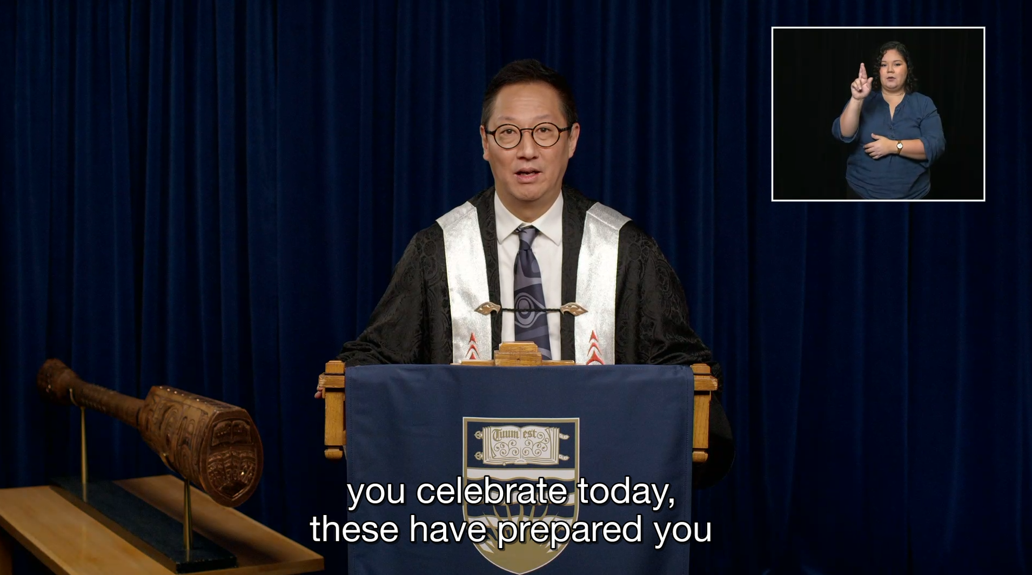
Tools for Increasing Accessibility in Video how to include the entire audience?
captions
transcripts
translation
colour blindness
sign language interpretation
descriptive video

Slide 7
Captions accessibility that’s become accessible
Captions can be optional via toggle, or “burnt in” permanently
SRT file – captions file
plain text that can be uploaded with video
One video can have multiple SRT files, one for each language

Slide 8
Captions accessibility that’s become accessible
Youtube and Kaltura – free auto-generation of captions
Usually contains errors, but editable within platform
Adobe Premiere
Steep learning curve, many errors
Editable plus control over aesthetic, position
Rev.com – srt production
Proofread by humans to increase accuracy
Delay due to human proofreading
Editable on platform
Notes:
Services will change, and technology will improve; these are the current options but will change

Slide 9
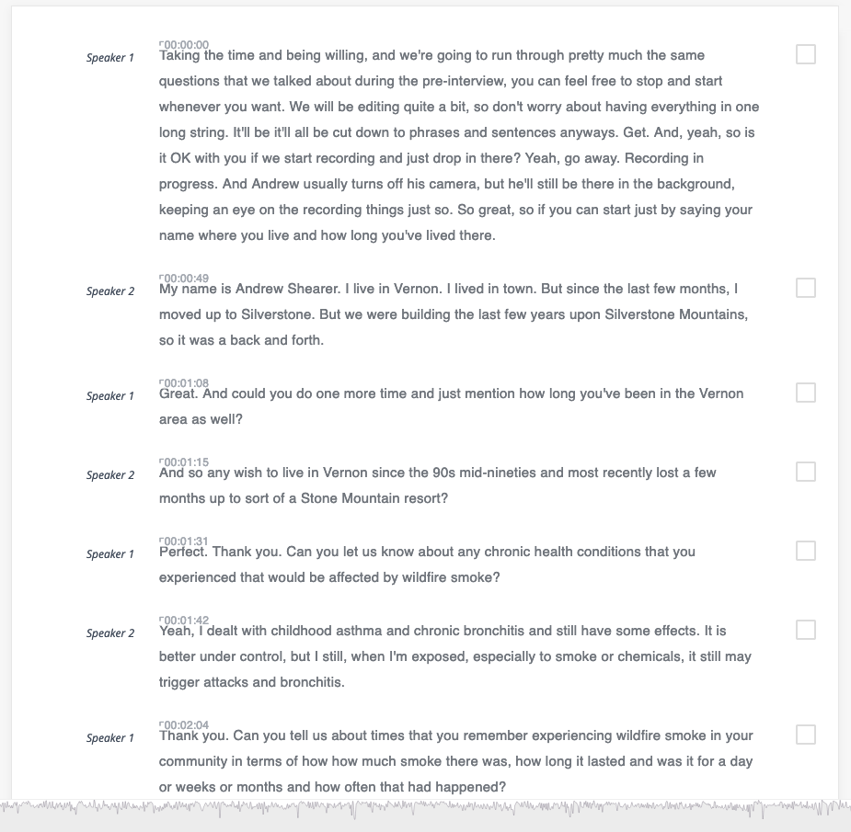
TRanscripts
Rev.com - $1.50 / min of video
Proofread by humans – “99% accurate”
Nvivo - Powerful database analysis software that also
produces accurate transcripts
Otter.ai
Free limited version, paid features
For live and pre-recorded video
Notes:
Services will change, and technology will improve; these are the current options but will change

Slide 10
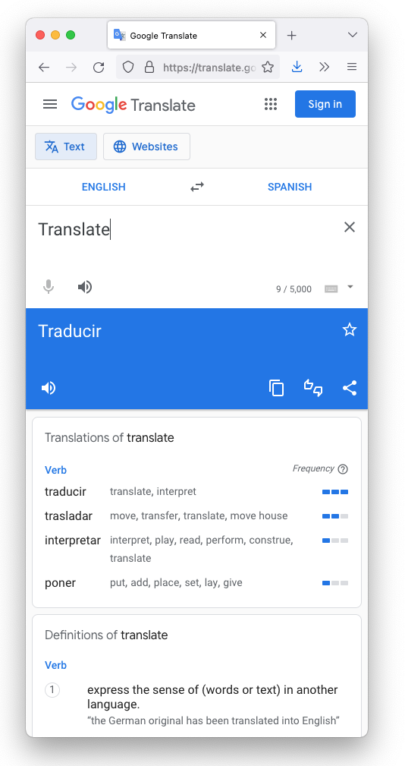
TRanslations
Rev.com starts at $5 US / min of video
Easy to edit on website
Proofreading
MOSAIC
departmental resources?
regional / cultural dialects and colloquialisms
Notes:
Services will change, and technology will improve; these are the current options but will change

Slide 11
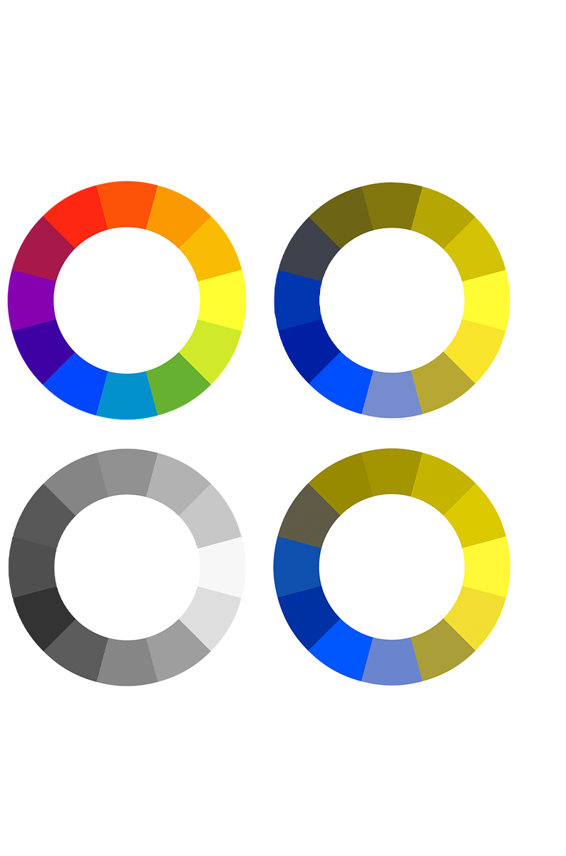
Adapting for colour
blindness
Adobe Photoshop
View > proof setup > color blindness
Image > mode > grayscale
Free apps
Notes:
Challenge that colour blindness can present for video content is when info is presented as colour on colour
- can’t just test contrast with greyscale
Protanopia, deuteronopia, greyscale

Slide 12
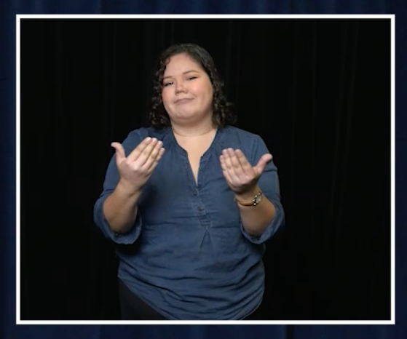
Sign language interpretation
Requires a trained and skilled interpreter
Involves nuance
facial tone, mood, emphasis in gestures
Ideally a team of two interpreters
Production of visual can theoretically be “DIY”
Time and tech intensive
Notes:
“live” or added to existing pre-recorded video

Slide 13
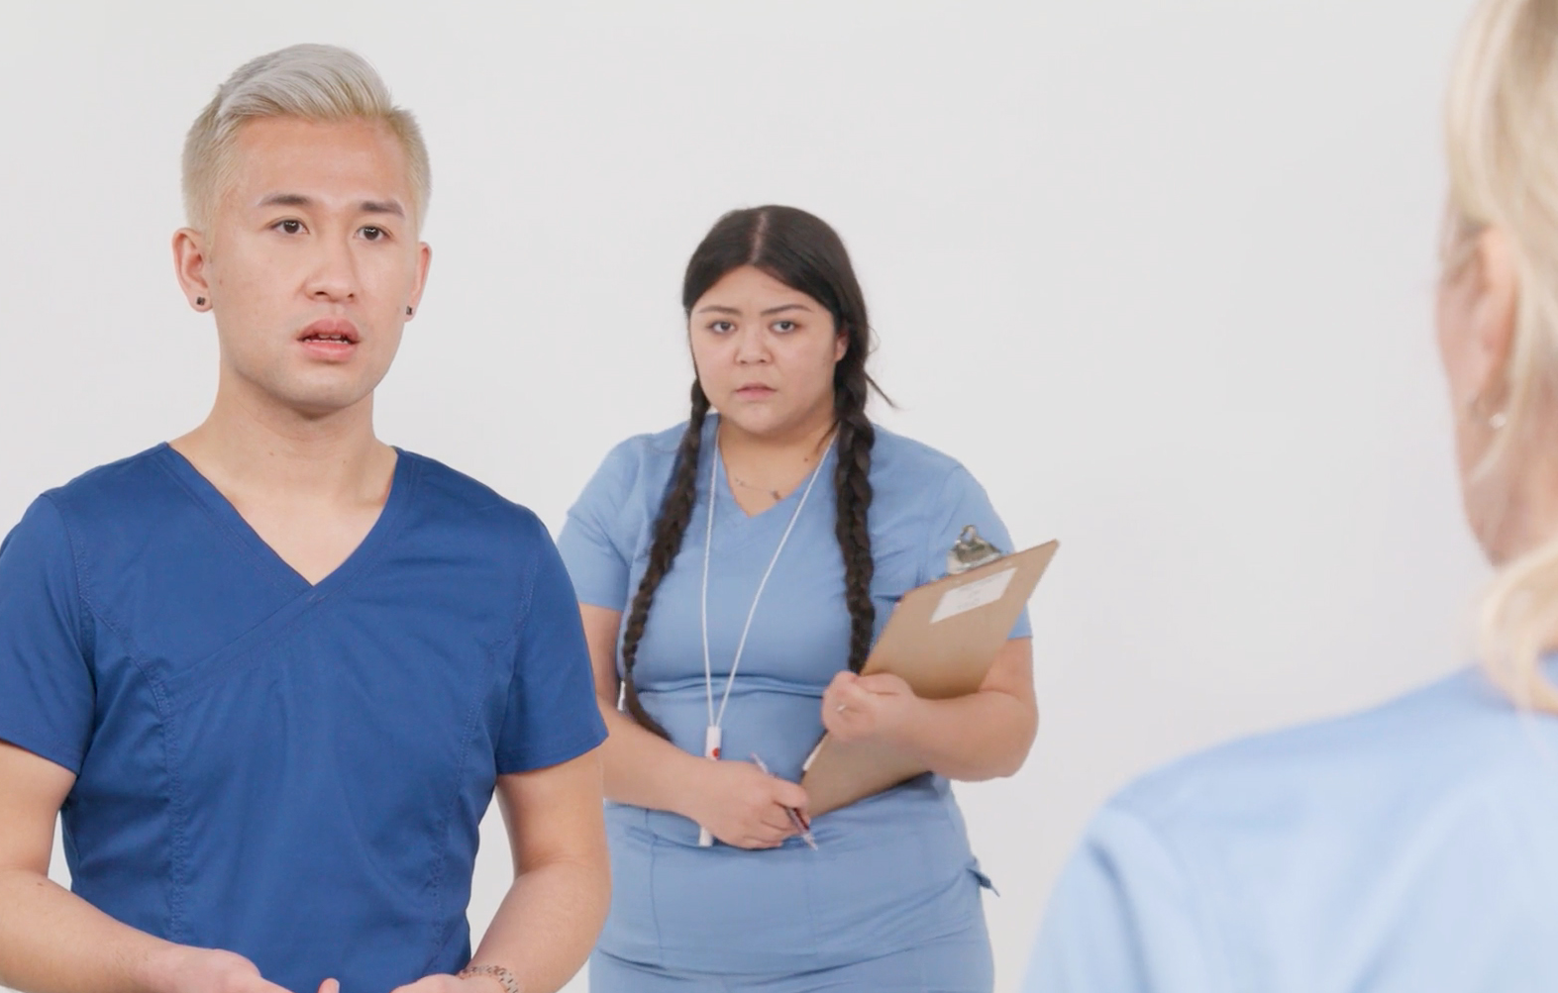
Descriptive Video
Narration describing visual elements
Usually added after media is produced
Can be challenging to fit additional narration
into existing edit
Additional narrator voice may change
pace and style
Integrated Descriptive Video
Incorporate at planning stage
Less resources required
Better production quality
pacing
Allows continuity of voices
Notes:
For blind and visually impaired, to make sure all visual info is available

Slide 14
Descriptive Video
Narration describing visual elements
Opportunities for Integrated Descriptive Video
Include descriptions in scripting
Describe lower thirds (name and title text)
Describe details of charts, tables, infographics
Describe any significant visual action
Let’s make it conventional!
Notes:
For blind and visually impaired, to make sure all visual info is available

Slide 15
Cognitive load when in doubt, simplify
Visuals, audio
make sure that the most available aspect is the intended focus
Scale, volume, motion
Layers – one thing at a time when content is essential
Unless the layers are reiterating the exact same content
Balancing two central goals
Capturing attention with variety, activity
Sharing information to be understood and retained
Mediate stimulation level to match the audience capacity and learning needs
Toggling complexity is the ideal
Versions?
Notes:
Text and VO must match
ask test audiences
This will make the specifics of the content more absorbable for everyone, including those who have attention challenges
Balancing act as we’re also working to keep viewer interested and engaged, catch their attention – giving familiar guiderails (character, arc, predictable recognizable ) while also making it interesting
Consider if a given image or clip is “load bearing” or “decorative/design” - AC and Will

Slide 16
Variety of means of engagement a principle of UDL
Video can be an alternate format in context of text and graphics
Within video, a variety of formats can be included
animation
static graphics, infographics
text, icons
Audio
Asynchronous video access allows:
Control over viewing pace, volume, context
Review before and after class for prep and reinforcement
Increased access to:
Field trip locations with virtual field trips
Experts through case study interviews
Notes:
Text and VO must match
ask test audiences
This will make the specifics of the content more absorbable for everyone, including those who have attention challenges
Balancing act as we’re also working to keep viewer interested and engaged, catch their attention – giving familiar guiderails (character, arc, predictable recognizable ) while also making it interesting
Consider if a given image or clip is “load bearing” or “decorative/design” - AC and Will

Slide 17
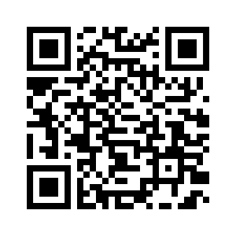
ubc.studios@ubc.ca
michael.sider@ubc.ca
Digital Media in Canadian Higher Education
Community of Practice

Slide 18
resources
Ubcstudios.ubc.ca
UBC Centre for Accessibility
UBC Centre for Workplace Accessibility
UBC Centre for Teaching, Learning and Technology
ctlt.ubc.ca
UBC Teaching and Learning Media Support
learning.video.ubc.ca
UBC Equity & Inclusion Office
equity.ubc.ca

