Slide 1
Supporting Students’ Digital Well-being when learning with (Generative) AI
Gwen Nguyen, Ph.D.
gnguyen@bccampus.ca
June 02, 2023

Slide 2
Outline:
What is digital well-being?
From digital aware to digital healthy in digital spaces
Digitally healthy with the PERMA framework when learning with AI tools
Photo by Leone Venter via unsplash

Slide 3
What comes to mind when you hear “digital well-being”?
Participants can vote at Slido.com with #3807392

Slide 4
Digital Well-being
Digital well-being means using technology in a way that promotes learners’ and educators’ success and holistic health. It is the capacity to use technologies to support personal health, safety, and relationships. It is the conscious use of technology as well as strategies to manage technology when it negatively impacts your health and to establish a work–life balance in digital spaces (JISC, 2015).

Slide 5
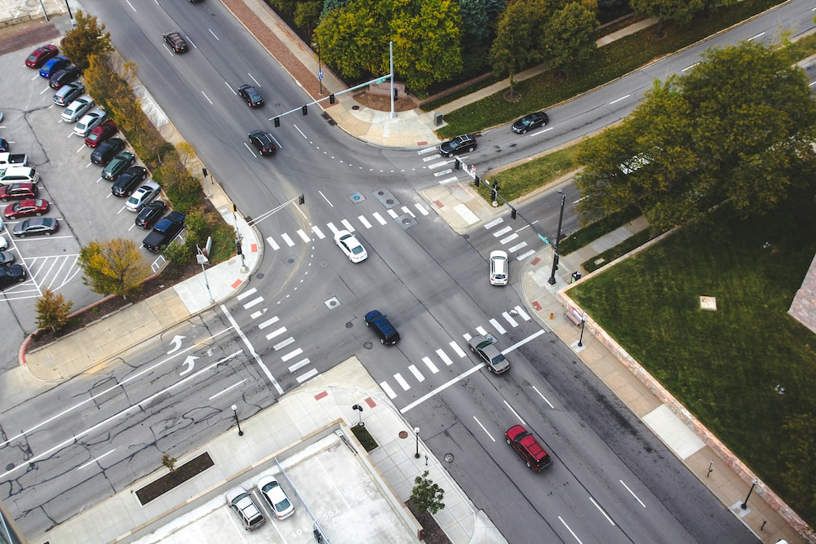
Picture by John Matychuk on unsplash

Slide 6
From “digitally aware” to “digitally healthy”
Photo by Lina Trochez via unsplash
Digitally Healthy
Privacy and security
Safety
Identity
Heath-related issues
Maintain a healthy balance between online and offline activities

Slide 7
PERMA framework
Positive emotion
Engagement
Relationships
Meaning
Accomplishment
Seligman (2012)
Notes:
https://www.frontiersin.org/articles/10.3389/feduc.2021.642632/full
5 facets of the PERMA flourishing framework Supporting Educator and Student Well-being in the Classroom (ucalgaryblogs.ca)
Positive emotions [feeling joy, hope, and contentment] → reduce stressors, promote positive coping and resilience
Engagement [feeling attached, involved and an ability to concentrate on activities] → create meaningful opportunities to draw on strengths and interests
Relationships [feeling connected, supported and cared about] → promote opportunities for collaboration, interaction withing and amongst teams
Meaning [feeling valued and connected to something greater than self] → connect to purpose and promote reflection
Accomplishment [progressing towards goals, feeling capable and a sense of accomplishment] → provide autonomy and celebrate success
Seligman, M. 2012. Flourish: A Visionary New Understanding of Happiness and Well-being. Atria books.
Slavin et al. 2012. PERMA: a model for institutional leadership and cultural change. Academic Medicine. 87, 1481.

Slide 8
Positive emotion
When you think about your own relationship, as it were, with AI, are they positive or negative?
Are you experiencing stress and anxiety because of generative AI? If so, what can you do to reduce the negative emotions?
Notes:
To support yourself
schedule time to recharge/ learn to put boundaries around your work
Implement gratitude practices
Ask for help, share your stressors appropriately with your colleagues, consider positive aspects of stress
To support students
Encourage students to share personal anecdote
Encourage a learning mindset
Create several low stakes assignments
Provide choice and voice in your assignments
Incorporate students voice in setting deadlines
Discuss openly with students about feedback/assessment rubrics/handling their workload in online spaces

Slide 9
Engagement
By engagement, when using these AIs are you getting into the flow?
Are AI tools giving you the chance collaborate with others, to share stories, to go with the flow, to relax, and find some quality time, to live in the present moment?
Notes:
To support yourself:
Learn to connect the course activities (content) to your passion and use technologies to support it
Look for opportunities for collaboration within and outside faculty
Share your stories and interests with students
Implement students’ feedback or communicate why you can’t, and that feedback has been heard.
To support students:
Provide choices in activities
Create space for students to participate verbally and in various ways in online spaces
Encourage students to teach and learn from each other
Try to bring real world connections to helps students see and make meaning in their learning process

Slide 10
Relationships
Are you able to use AI to make new connections or strengthen relationships that you have?
Are you able to avoid are negative relationships and interactions via these tools?
Notes:
To support yourself: Use technologies to
Connect with the community of practice
Share, co-construct, gather feedback on course materials
write a letter of support to students, your colleagues
Connect with real world challenges
Invite people for coffee
To support students
Encourage students to engage in peer-learning, discussion activities
Use technologies to set up mini conferences for students to showcase projects
Incorporate and provide support for group works
Encourage online study groups
Collaboratively

Slide 11
Meaning
Does your use of these AI tools help you achieve greater meaning?
Notes:
To support yourself: Use technologies to
Seek opportunities to mentor
Share all volunteer opportunities in your field with students
Share your positionality, teaching philosophy, or other teaching/learning reflexive practices with students
To support students:
Model reflection, engage students in reflective practices (metacognitive activies – for example, exam wrappers)
Promote experiential learning opportunities, co-op programs
Be flexible – course correct if meaning is getting lost
Provide context around why the class, the activity is meaningful

Slide 12
Accomplishment
Does using AI help you:
aim higher?
allow time to celebrate little things?
Notes:
To support yourself
Keep notes of your successes (after class, at the end of the week)
Set clear and achievable goals (monthly, annually) and have plans for celebrating them with peers SMART goals (specific, measurable, achievable, realistic, and timebound (Falecki et al, 2018)_
Celebrate online peer support
Share key successes at learnings with others at team meetings
Set markers to see improvement in teaching and feedback
To Support students: Use technologies to
share positive and balanced feedback verbally and during grading
Encourage students to recognize their successes by final reflections
Provide tutorials onlines (allow students to select from a series of questions to repond to in their assignment)
Design projects (open-ended) to give students choice in the topic that interests them
Let students propose their own assignment
Add optional assignments to foster a learning mindset

Slide 13
5-5-5 for Think-Pair-Share
Think
OFF
Do some movement
Pair
Let’s connect and hear some ideas in a pair/small groups
Share
We are all in this together
1 thing that you did/would do to promote digital wellness

Slide 14
Reference
Cecchinato, M. E. et al. (2019). Designing for Digital Wellbeing: A Research & Practice Agenda. In Extended Abstracts of the 2019 CHI Conference on Human Factors in Computing Systems (Glasgow, Scotland Uk) (CHI EA ’19). Association for Computing Machinery, New York, NY, USA, 1-8. https://doi.org/10.1145/3290607.3298998
Harward, D. W. (2016). Well-being essays and provocations: Significance and implications for higher education, in D. Harward (Ed) Well-being and Higher Education: A strategy for change and Realization of Education’s Greater Purpose, p. 3-17.
Joint Information Systems Committee (JISC). (2015). Building digital capabilities: The six elements defined. https://repository.jisc.ac.uk/6611/1/JFL0066F_DIGIGAP_MOD_IND_FRAME.PDF
Seligman, M. (2012). Flourish: A visionary new understanding of happiness and well-being. Free Press.

