Slide 1
ChatGPT and (Academic) Integrity
Gwen Nguyen, Ph.D.
gnguyen@bccampus.ca
June 01, 2023

Slide 2
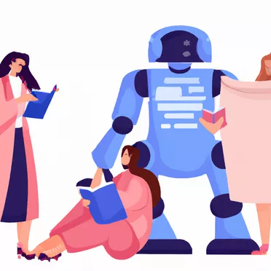
ChatGPT and (Academic) Integrity

Slide 3
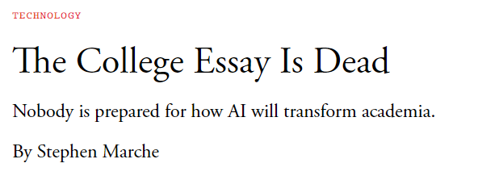

Slide 4
Are you using ChatGPT?

Slide 5
Do you allow students to use ChatGPT in the coursework?

Slide 6
What comes to mind when you hear the word “Integrity”?

Slide 7
(Academic) Integrity
Integrity is “the quality of being honest and having strong moral principles that you refuse to change.”
(Cambridge Dictionaries Online, 28 June, 2011 )
Notes:
Academic integrity is a demonstration of personal integrity in an academic environment. [Personal integrity is a way of activng that others would see as honourable. It is a demonstration of high moral values and ethical beliefs. We value people who demonstrate integrity and we would like others to see us as people with integrity]. Academic integrity forms the basis of academic work in any institute of higher learning and is built on the principles of fairness, honesty, trust, respect, responsibility, and courage. Making a commitment to not engage in acts of dishonesty, falsification, misrepresentation, or deception is the first step in preserving academic integrity.

Slide 8
(Academic) Integrity
Honesty
Respect
Fairness
Trust
Courage
Responsibility
International Center for Academic Integrity ,2021
Notes:
Students: you want to know your work is being fairly evaluated and this includes knowing that other students do not have an unfair advantage through cheating. You are responsible for academic work that you submit or work on with others. This means that no cheating, no plagiarizing, fasifiying materials, using an unauthorized editor or acting in other academic dishonest ways.
This will be integral to students’ success in their community and workplace.

Slide 9
ChatGPT
Unpermitted Assistance?
Missing or inadequate attribution (i.e. plagiarism)
Combating Academic Dishonesty, Part 6: ChatGPT, AI, and Academic Integrity | Academic Technology Solutions (uchicago.edu)
Notes:
ChatGPT-generated text has proved itself capable of evading plagiarism checkers such as Turnitin.
ChatGPT also ties into broader issue of contract cheating (third party to do work)

Slide 10
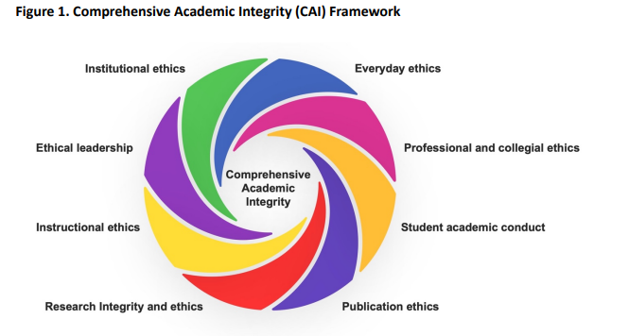
(Eaton, 2023)

Slide 11
Be
straightforward
authentic
vulnerable
compassionate
available

Slide 12
Ethical instructional praxis with ChatGPT
Tell students about appropriate use.
Design some assessment that ChatGPT will have difficulty .
Encourage in-class groups to reduce unauthorized assistance of many kinds.
Ask for first draft and assignments to be submitted in stages
Explain the shortcomings of ChatGPT and learning-centred and ethical reasons

Slide 13
Reference
https://onlineacademiccommunity.uvic.ca/TeachAnywhere/wp-content/uploads/sites/4913/2021/11/LTSI-Academic-Integrity-Framework.pdf
Eaton, S.E. (2023). A Comprehensive Academic Integrity (CAI) Framework: An Overview. Calgary, Canada: University of Calgary.
https://prism.ucalgary.ca/server/api/core/bitstreams/d760684a-f03a-464a-a69b-eb6d0e726ec8/content

