Slide 1
DIGITAL LITERACIES
ETUG SPRING WORKSHOP 2023
DIGITAL LITERACIES MODULES SHOWCASE
Faeyza Mufti, MET, Manager, Learning Design
Jamilee Baroud, PHD, Curriculum & Evaluation Consultant
Gabrielle Coombs, BA, Learning Designer
Notes:
Slide one: Introduction slide

Slide 2
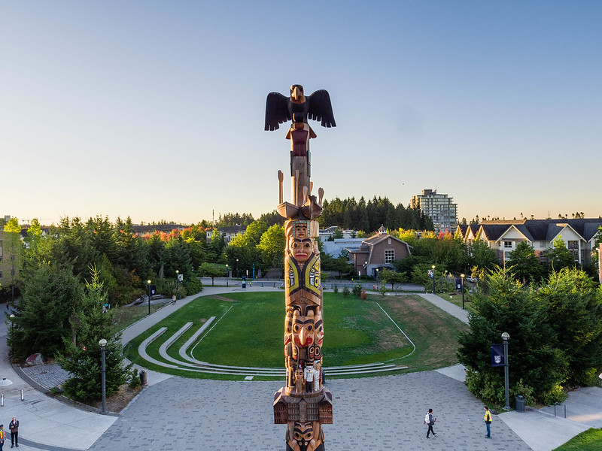
ETUG SPRING WORKSHOP 2023
DIGITAL LITERACIES MODULES SHOWCASE
Land Acknowledgement
Notes:
Slide one: Introduction slide

Slide 3
ETUG SPRING WORKSHOP 2023
DIGITAL LITERACIES MODULES SHOWCASE
Agenda
Define what we mean by digital literacies
Provide context for the design of the modules
Deep dive into inclusive design
How we promote the adoption of digital literacies
Looking to the future
Notes:
Slide one: Introduction slide

Slide 4
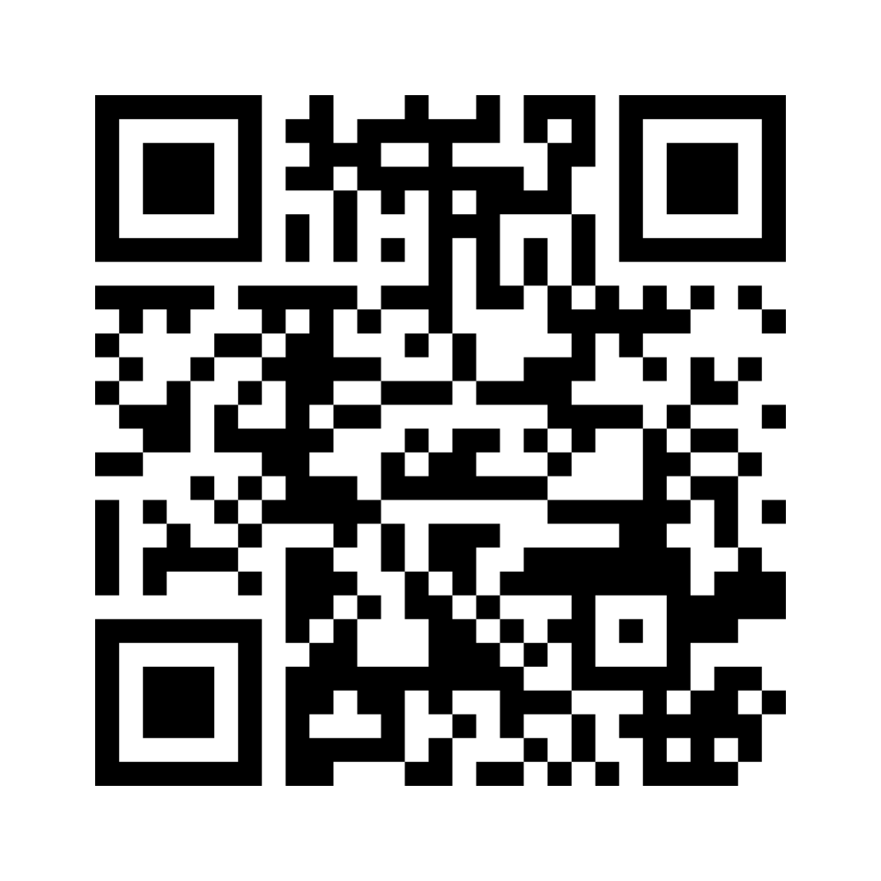
ETUG SPRING WORKSHOP 2023
DIGITAL LITERACIES MODULES SHOWCASE
Defining Digital Literacies
Define Digital Literacies in 3 words
Share your answers in our Mentimeter by scanning the QR code on the right, or using this link: https://www.menti.com/alt146nz4a18
Notes:
Slide one: Introduction slide

Slide 5
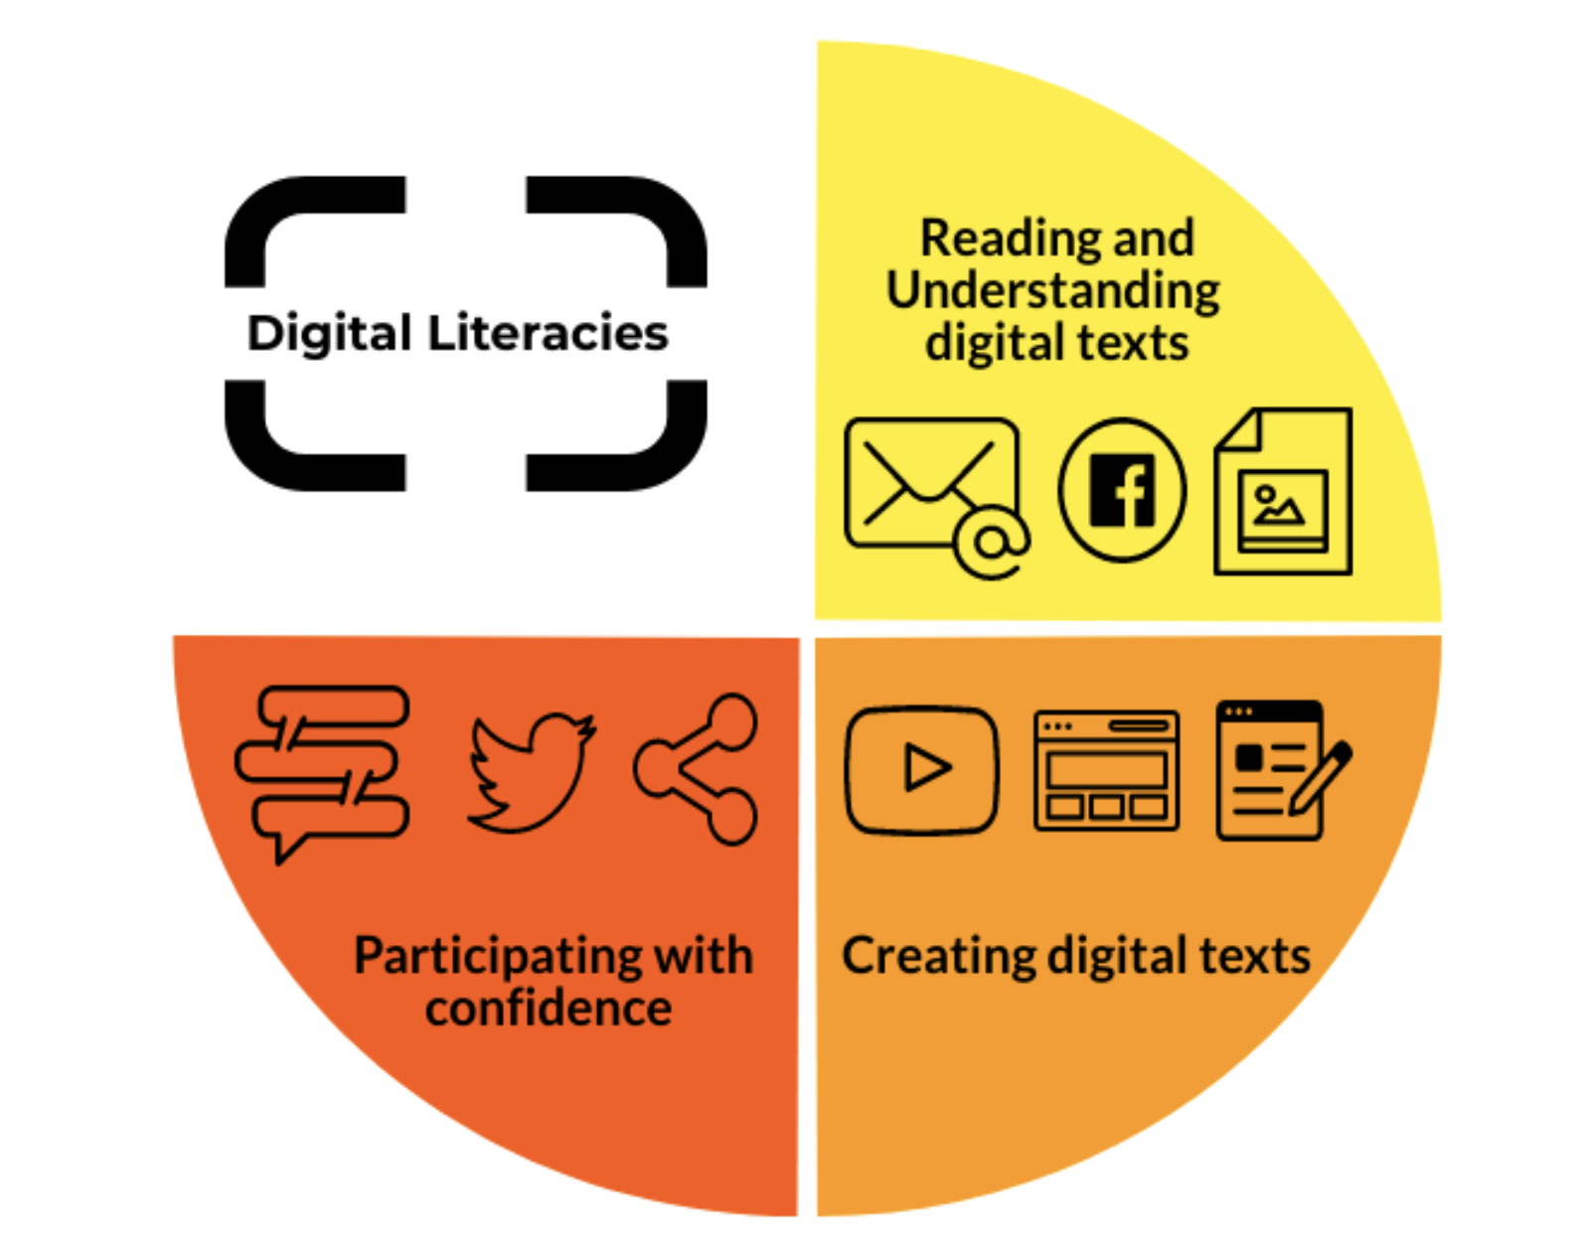
ETUG SPRING WORKSHOP 2023
DIGITAL LITERACIES MODULES SHOWCASE
Foundational Components
Skills
Practices
Mindsets
Ways of thinking
Needed to make meaning with digital texts, from digital texts, and in digitally mediated environments.
Cotnam-Kappel, M & Hagerman, M. (2020)

Slide 6
ETUG SPRING WORKSHOP 2023
DIGITAL LITERACIES MODULES SHOWCASE
Young People's Literacies in the Digital Age
"How have we arrived at a situation in which we adapt to technology, rather than it being adapted to us?”
Luci Pangrazio

Slide 7
ETUG SPRING WORKSHOP 2023
DIGITAL LITERACIES MODULES SHOWCASE
The Myth of the Digital Native
“Despite their use of digital media, many of the young people did not demonstrate a well-developed critical disposition toward the technologies they used. This is not to suggest that they were unwilling to critique, but rather that they had few opportunities to cultivate these sorts of critical understandings.”
Luci Pangrazio

Slide 8
ETUG SPRING WORKSHOP 2023
DIGITAL LITERACIES MODULES SHOWCASE
Critical Digital Literacies
CRITICAL Digital Literacies are informed by knowledge of:
How digital systems are designed
The values that digital systems advance/perpetuate
The interests that digital systems serve
Power, who has it, and why

Slide 9
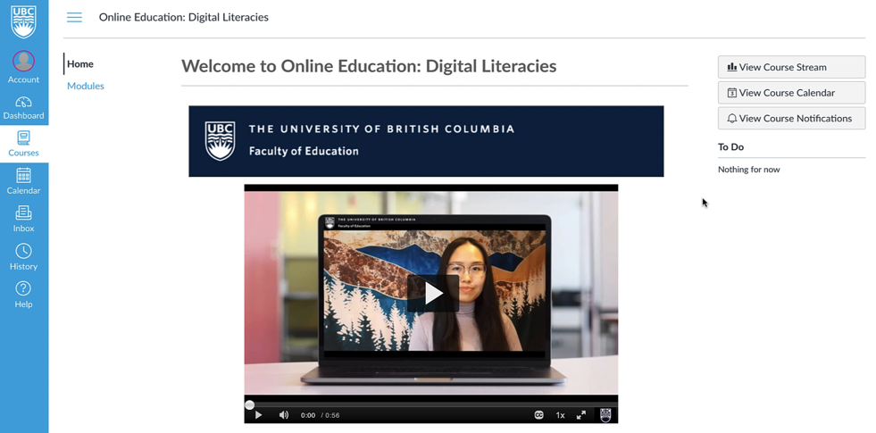
ETUG SPRING WORKSHOP 2023
DIGITAL LITERACIES MODULES SHOWCASE
Introducing the Digital Literacies Modules
Notes:
Add gif of modules here

Slide 10
ETUG SPRING WORKSHOP 2023
DIGITAL LITERACIES MODULES SHOWCASE
Inclusive Design and Digital Literacy
UBC has more 'untraditional' students than ever before
Diversity ≠ equity and access
We have an obligation to challenge barriers to access
Digital Literacies helps challenge these barriers
Notes:
Slide one: Introduction slide

Slide 11
ETUG SPRING WORKSHOP 2023
DIGITAL LITERACIES MODULES SHOWCASE
Inclusive Design and Digital Literacy
How can instructors and students alike feel seen and heard in their courses, and how can we design our courses to honor that and to ensure that we are pushing for equitable learning experiences?
How can all students and instructors feel confident in engaging with online learning because they feel welcome and capable, and how can we give voice to those who historically have been denied that opportunity?
Notes:
Slide one: Introduction slide

Slide 12
ETUG SPRING WORKSHOP 2023
DIGITAL LITERACIES MODULES SHOWCASE
Deeper Dive: Accessibility
Disability encompasses a broad range of lived experience
Not all students with disabilities seek accommodations
Seeking accommodations in and of itself is exhausting
Notes:
Slide one: Introduction slide

Slide 13
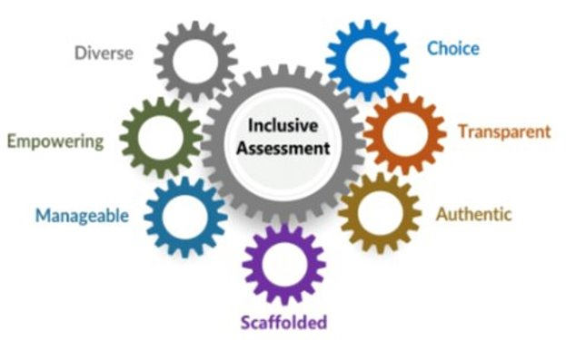
ETUG SPRING WORKSHOP 2023
DIGITAL LITERACIES MODULES SHOWCASE
Accessibility and Inclusive Design
Universal Design for Learning
Digital Maker Technologies as Inclusive Assessment
Web Accessibility
UCD Teaching and Learning (2023)
Notes:
Slide one: Introduction slide

Slide 14
ETUG SPRING WORKSHOP 2023
DIGITAL LITERACIES MODULES SHOWCASE
Inclusive Assessment
Poor performance is often assumed to be a problem with the student rather than the assessment. This deficit framing meant that the “problem” could be resolved through student- focused measures such as individual accommodations and/or additional support (O’Shea et al., 2016), rather than considering what could be problematic about the assessment.
(Tai et al., 2022)
Notes:
Slide one: Introduction slide

Slide 15
ETUG SPRING WORKSHOP 2023
DIGITAL LITERACIES MODULES SHOWCASE
Feedback
"I found it important to go over my biases when it comes to understanding the internet and how people interact on various platforms. All of the modules helped me come up with ideas for diverse learners and has opened up my mind to new online teaching formats and the delivery of content, support, encouragement, and assessment."
Digital Literacies Feedback Survey Response
Notes:
https://www2.gov.bc.ca/assets/gov/education/kindergarten-to-grade-12/teach/teaching-tools/digital-literacy-framework.pdf

Slide 16
ETUG SPRING WORKSHOP 2023
DIGITAL LITERACIES MODULES SHOWCASE
Consuming. Creating. Communicating.

Slide 17
ETUG SPRING WORKSHOP 2023
DIGITAL LITERACIES MODULES SHOWCASE
Action – Looking to the Future
"A digitally literate person demonstrates an informed, open-minded, and balanced attitude towards information society and the use of digital technology, is curious, aware of opportunities and new developments, and is comfortable to explore and exploit them."
BC’s Digital Literacy Framework

Slide 18
ETUG SPRING WORKSHOP 2023
DIGITAL LITERACIES MODULES SHOWCASE
Digital Literacies and Generative AI
How have we arrived at a situation in which we adapt to emerging technologies (like generative AI) rather than it being adapted to us?
How can we become better equipped with the skills and competencies to critically and successfully evaluate AI in education for the betterment of society?
Notes:
Slide one: Introduction slide

Slide 19
ETUG SPRING WORKSHOP 2023
DIGITAL LITERACIES MODULES SHOWCASE
References
Cotnam-Kappel, M., & Hagerman. M. (2020). La formation Bricoleur: Un modèle informé par les expériences et voix du personnel enseignant. Revue des sciences de l'éducation, 46(1), 117-150.
King, A.D. (2022). Feeling (Un)Seen. In Quinn, J., Burtis, M., Jhangiani, S., & Denial, C.J. Designing for Care, Hybrid Pedagogy Inc.
O’Shea, S., Lysaght, P., Roberts, J., & Harwood, V. (2016). Shifting the blame in higher education – Social inclusion and deficit discourses. Higher Education Research and Development, 35(2), 322–336. https://doi.org/10.1080/07294360.2015.1087388.
Pangrazio, L. (2018). Young people's literacies in the digital age: Continuities, conflicts and contradictions. Routledge.
Spires, H., & Bartlett, M. (2012). Digital literacies and learning: Designing a path forward. Friday Institute White Paper Series, 5, 1-24.
Tai, J., Ajjawi, R., Boud, D., & de St Jorre, T. J. (2022). Promoting equity and social justice through assessment for inclusion. Assessment for Inclusion in Higher Education (pp. 9-18). Routledge.
Modules Enrolment Link: https://courses.cpe.ubc.ca/browse/ubcv/faculty-of-education/courses/online-education-digital-literacies

Slide 20
ETUG SPRING WORKSHOP 2023
DIGITAL LITERACIES MODULES SHOWCASE
Feedback
"Thank you very much! The whole course was wonderful and a great introduction to online learning and resources. I was glad to have been able to complete this course before the start of the fall term so that I could explore the additional links, test out some applications, find the applications that work for me, and have time to reflect on how I will use these resources for physical and digital spaces. I have had time to reflect on my personal statement and I am glad to have been introduced to the idea."
(Digital Literacies Feedback Survey Response)

