Slide 1
Celebrating The Whole Student
Using ePortfolio to create meaningful learning experiences and authentically assess learning
Notes:
https://kpuemp-my.sharepoint.com/:w:/g/personal/lisa_gedak_kpu_ca/EYQ2949m2RBLijpfrMcK-m8B8F25vQXmyIwqq60hv7jmTg?e=EQYbLO

Slide 2
TERRITORIAL
ACKNOWLEDGMENT
We would like to acknowledge that KPU is located on the traditional, ancestral, and unceded lands of the Coast Salish Peoples. This includes the territories of the Kwantlen First Nation, who bestowed their name on this university .
We thank all First Nations for sharing their Land and resources with us in friendship and in peace.

Slide 3
Session Overview
Intro to "Folio Thinking"
Celebrating the whole student
A look at the emerging research
Discussion

Slide 4
Think back..
...to an assignment you did in school that recognized and celebrated you as a whole person & allowed you to incorporate parts of your personal self? (volunteer, extracurriculars, values)
*anywhere in your learning journey K12 to post-secondary

Slide 5
What is Folio Thinking?
Collecting, organizing, sharing & reflecting on learning experiences their value & their connectedness to construct deeper meaning over time.
Folio Thinking is a reflective practice that fosters deeper learning

Slide 6
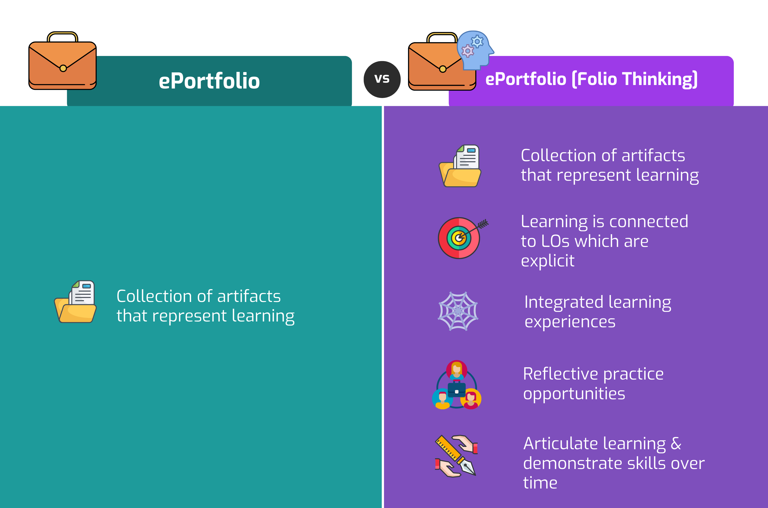
Traditional ePortfolios vs. "Folio Thinking"

Slide 7
What does Folio Thinking look like in practice?
Integration of unique life experiences with curriculum
Opportunities to make connections across time
Development of self-identity
Evidence impact of learning across time

Slide 8
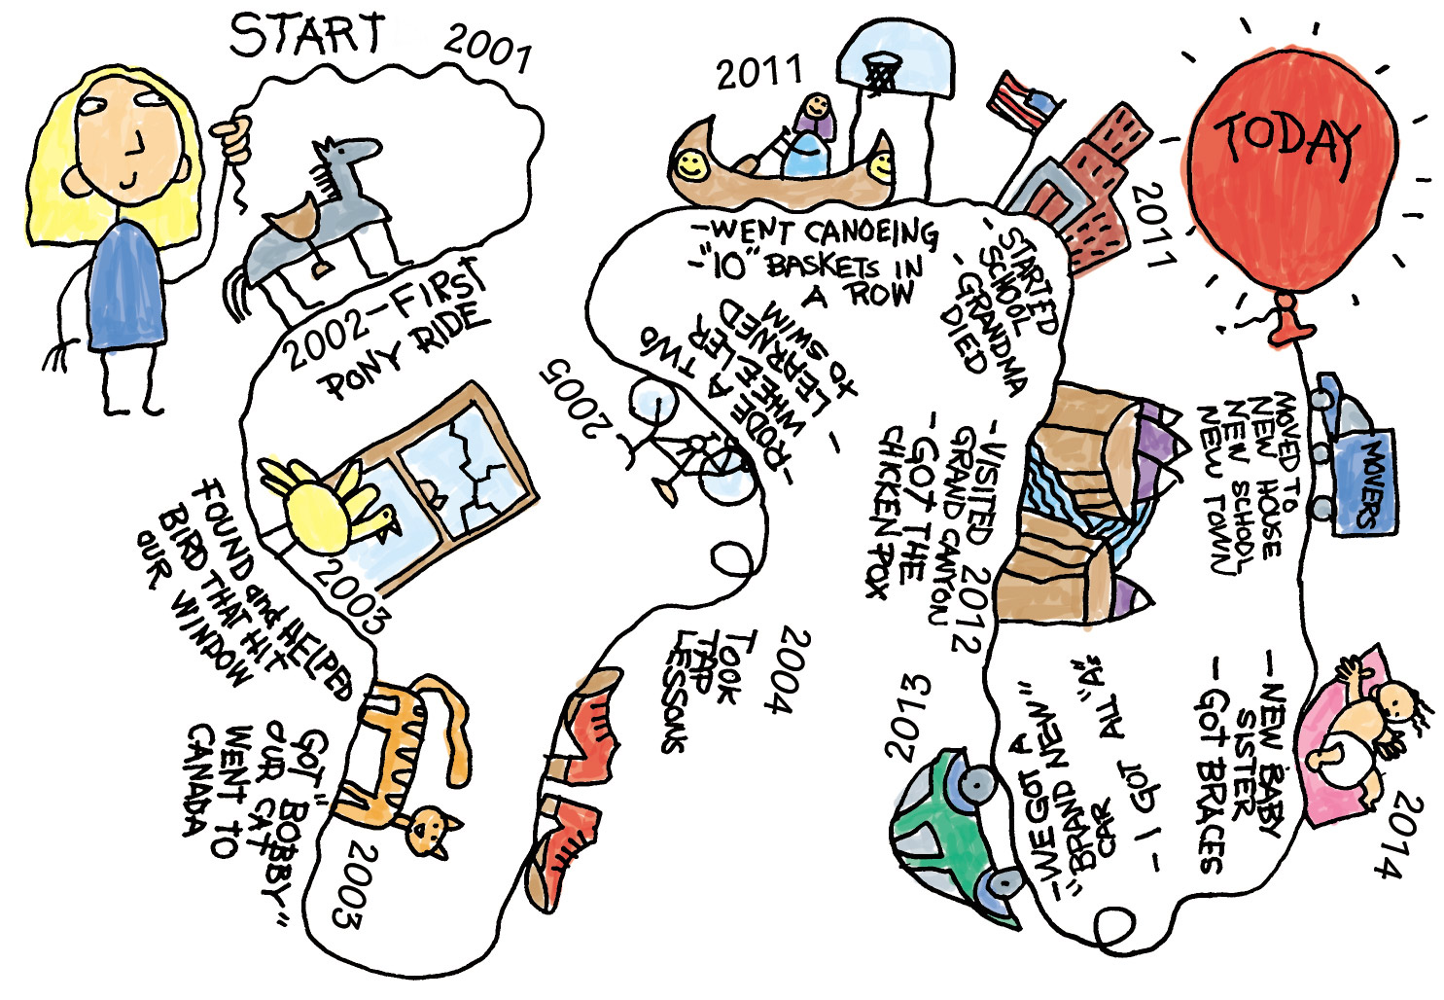
Capture aspects of a student’s life & personal brand, incorporating who they are outside of the curriculum.
Reflect on & share personal experiences: volunteering, extracurriculars, personal values & interests. Designed & displayed to showcase student’s uniqueness (student's design and content)
This Photo by Unknown author is licensed under CC BY-SA-NC.

Slide 9
Supports & Celebrates the Entire Student
Student agency – What they share, with who they share, how they share
Opportunities to share who they are outside of curriculum & connect self to studies
Social constructivist & not solo activity – feedback from peers, family, external reviewers
Freedom to fail, reflect on experience and adapt through continuous learning
Celebrate and showcase achievements, knowledge, skills, and abilities
Light et al. (2011)

Slide 10
What Emerging Research Says Supports and Celebrates the Whole Students Learning Journey
Scaffolding
Reflection
Metacognition

Slide 11
Scaffolding
“scaffolding strategies should be incorporated into the learning environment to help students develop their ability to reflect on their own learning” (Porntaweekul et al. 2016) ​
Scaffolded experiences = more student agency, flexibility and creativity
Not just in creative disciplines - increasingly noncreative disciplines, technical & vocational training
"In changing the way, we teach and learn, we need to provide scaffolds instead of knowledge, to facilitate instead of lecture, to focus on learning skills instead of learning content, and to help students document their learning process instead of teaching them how to create a learning artifact" (Chen et al, 2019)
​

Slide 12
Reflection
“The power of reflection is highly acknowledged to promote learning and develop expertise, yet reflective skills are rarely explicitly taught in schools” (Ebil et al, 2020)
Students that develop reflection into a habit also gain a valuable employability skill, in a rapidly evolving society of the twenty-first century, and those who are receptive and have the self-awareness abilities will typically succeed in their job pursuit (Helyer and Lee 2014).
"As the world prepares for the fourth industrial revolution, educators will need to shift their focus on personalised and lifelong learning. Reflection skills will be one of the necessary life skills which students have to learn to survive and thrive"(Ebile et al, 2020)

Slide 13
Metacognition
ePortfolios are tools that cultivate student higher order thinking (Daunert and Price, 2014) and for instructors, ePortfolios allow them to situate 21st Century learning competencies into their practices (Tan et al.)
“e-Portfolios can provide a dynamic, living space where ongoing professional statements and reflections are accessible to a full professional learning community.
Students in the classroom do not naturally acquire reflective skills so it is necessary for them to be guided by the instructor in developing them while creating their ePortfolios through careful scaffolding (De Jager, 2019) which will then lead to metacognition and higher order thinking.

Slide 14
1.Clearly define assessment criteria
​​2.Rubrics outlining key elements you want to assess​
3.Formative & summative assessments​​
4.Peer assessment for additional perspectives​​
5.Real-world authentic assessments
6.Reflection & self-assessment
7.Multiple modes of evidence​
8.Timely and constructive feedback
9.Authentic audience beyond professor​
10.Continuous refinement & improvement

Slide 15
Now what?
Can you think of an assignment or assessment you could reimagine that would support and celebrate your students as a whole person & allow them to bring themself into the curriculum?
*SHARE OUT!

Slide 16
Discussion

Slide 17
Thank You
This Photo by Unknown author is licensed under CC BY-SA.

Slide 18
References
Chen, W., Shah, U. V., & Brechtelsbauer, C. (2019). A framework for hands-on learning in chemical engineering education—Training students with the end goal in mind. Education for Chemical Engineers, 28, 25-29.
Daunert, A. L., & Price, L. (2014). E-portfolio: a practical tool for self-directed, reflective, and collaborative professional learning. Discourses on professional learning: On the boundary between learning and working, 231-251.
De Jager, T. (2019). Impact of ePortfolios on Science student-teachers’ reflective metacognitive learning and the development of higher-order thinking skills. Journal of University Teaching & Learning Practice, 16(3), 3.
Helyer, R., & Lee, D. (2014). The role of work experience in the future employability of higher education graduates. Higher Education Quarterly, 68(3), 348-372.
Hj. Ebil, S., Salleh, S. M., & Shahrill, M. (2020). The use of E-portfolio for self-reflection to promote learning: A case of TVET students. Education and Information Technologies, 25(6), 5797-5814.
Porntaweekul, S., Raksasataya, S., & Nethanomsak, T. (2016). Developing Reflective Thinking Instructional Model for Enhancing Students' Desirable Learning Outcomes. Educational Research and Reviews, 11(6), 238-251.
Tan, L., & Koh, J. (2014). Self-directed learning: Learning in the 21st century education. Educational Technology Division, Ministry of Education.

