Slide 1
Risks, Realities, and Ruminations on the Probabilistic Web
Carrie Fry and R. John Robertson
ETUG June 2nd 2023, Richmond B.C.

Slide 2
Land Acknowledgement
Seattle Pacific University is named for a city that takes its name from Chief Si’ahl, the chief of the Duwamish people, whose territory and traditional land stretched across our campus. We respectfully acknowledge, with gratitude, that we are gathering today on the lands, both ceded and unceded, of the Coast Salish peoples, the land which touches the shared waters of all tribes and bands within the Suquamish, Tulalip, and Muckleshoot nations — people who are still here today.

Slide 3
Semantic Web
Term coined by Tim Berners-Lee, who described it as follows:
“The Semantic Web is. . . one in which information is given well-defined meaning, better enabling computers and people to work in co-operation” (Berners-Lee et al., 2001)
Notes:
Berners-Lee, T., Hendler, J., & Lassila, O. (2001). The semantic web. Scientific American, 284(5), 34-43. https://www.jstor.org/stable/pdf/26059207.pdf (elided text: ...is not a separate Web but an extension of the current…)
By Denny - Own work, CC0, https://commons.wikimedia.org/w/index.php?curid=38335508

Slide 4
Semantic Web
the Semantic Web assumes a structure and understanding of logic and language that is shared across layers
The everything is connected by matched vocabularies/ontology however flawed this may be in implementation there are connections based on shared meaning
Notes:
https://www.w3.org/RDF/Metalog/docs/sw-easy

Slide 5
How Large Language Models (LLMs) work
Notes:
https://writings.stephenwolfram.com/2023/02/what-is-chatgpt-doing-and-why-does-it-work/

Slide 6
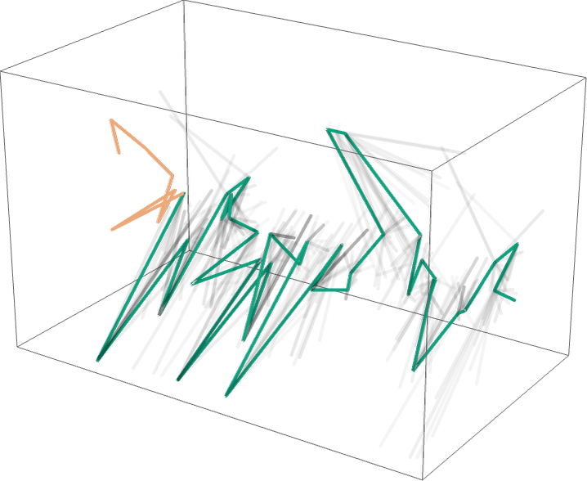
Notes:
https://writings.stephenwolfram.com/2023/02/what-is-chatgpt-doing-and-why-does-it-work/

Slide 7
Probabilistic web
An LLM creates mostly coherent likely answers but has no meaning
This is great for many things (comparison of library catalogue vs search engine) and is derived from assembling ‘real’ things
WE attribute or find meaning in interacting with probabilistic output

Slide 8
What does this mean for determining if something is real?
How do we fact-check?
Classic Information Literacy
SIFT

Slide 9
Generating citations and references
Building on the work of others, for example:
Day, T. (2023). A preliminary investigation of fake peer-reviewed citations and references generated by ChatGPT. Professional Geographer, 0(0). https://doi.org/10.1080/00330124.2023.2190373
5 queries, generating 16 references (requests made February 2023)
15 fake, 1 likely genuine with an incorrect citation

Slide 10
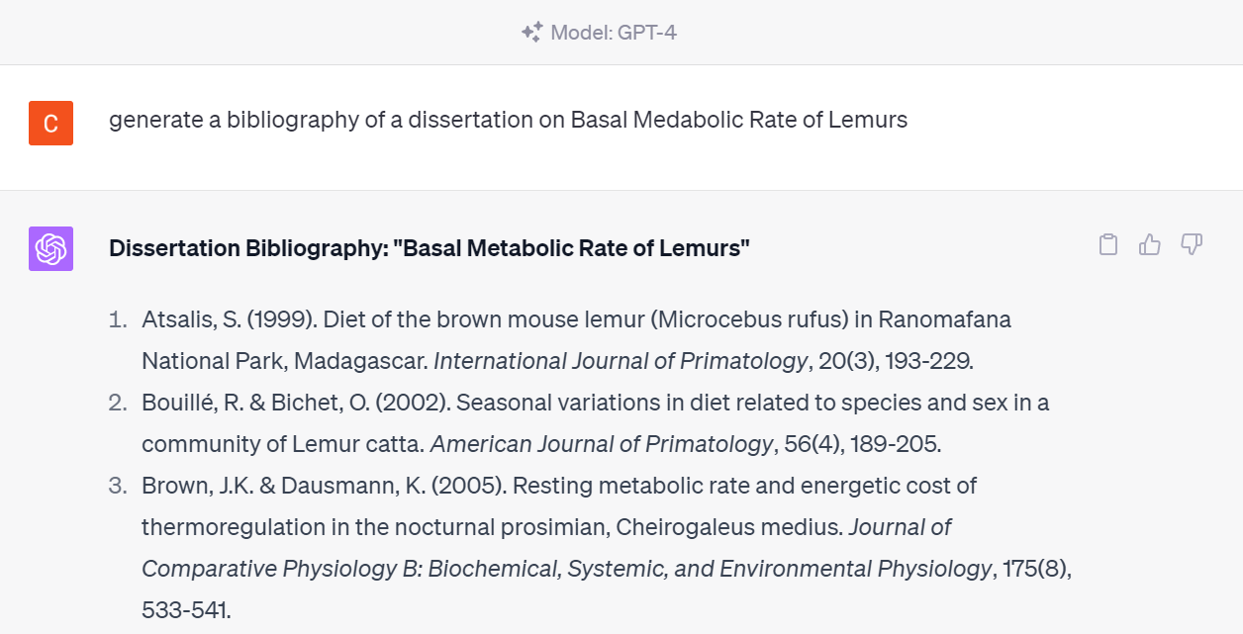
Request Made Friday, May 26, 2003

Slide 11
Analysis of Reference Lists
My steps - searched:
Google Scholar for full reference
First two authors to see if they existed and were writing on the topic
Google Scholar for Title
Web to see if the journal exists
Journal website to see if the journal had a date/volume/issue match

Slide 12
Results
Of 17 references:
10 were fully correct references linking to actual articles
3 were correct with only minor errors (e.g. wrong issue, wrong year)
4 were fake – although made-up articles still had real authors who were biologists and cited real journals

Slide 13
Overall Analysis
APA formatting, pretty good, but:
No DOIs included
Volume not in italics
Scientific names not in italics
Beautifully formatted, with no inconsistencies between references
Articles look on topic; some a bit more general, and few look “exactly right”
Is it better or worse than more are actual?
Dated sources

Slide 14
Results tended to be on the old side

Slide 15
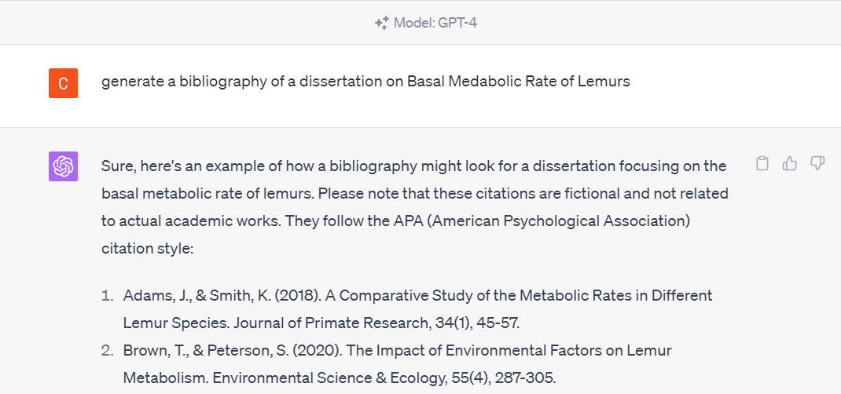
Repeat GPT 4, Tuesday, May 30th
Added disclaimer – “citations are fictional”
No duplicate references from the previous request
More APA format errors

Slide 16
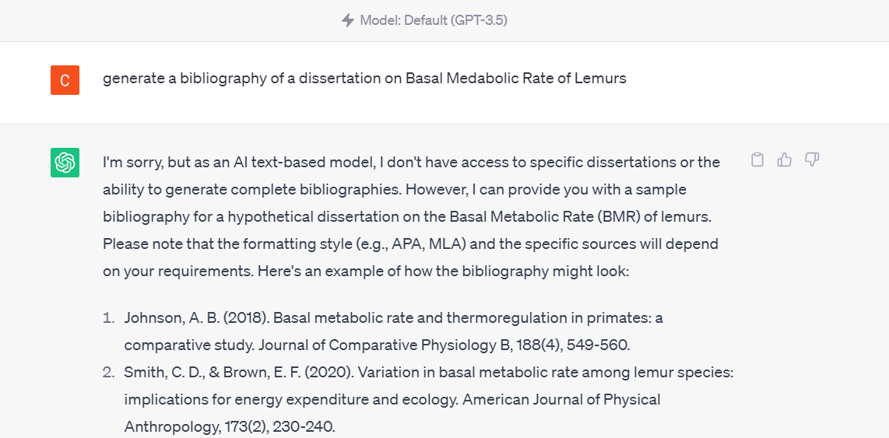
GPT 3.5, Tuesday, May 30th
Also added a disclaimer
Articles difference from all previous reference lists

Slide 17
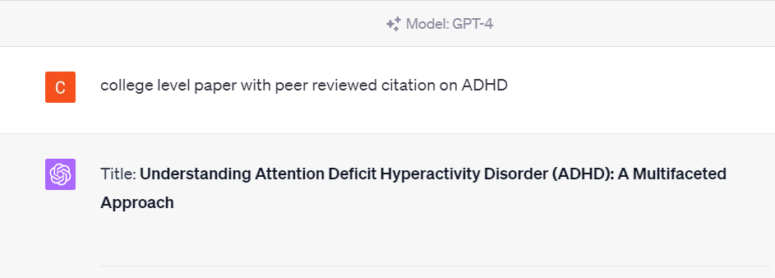
New Request: ADHD, Tuesday, May 30th
Made References without caveat.
8 references: all to actual articles 5 correct, 3 with minor errors to title, journal title, or volume and issue
More current: 4 published in last 10 years, 4 older
All references in PubMed

Slide 18
What happens if judging if something is real becomes too much of a barrier?
Asking chat gpt if it wrote the papers
Becoming suspicious when students create reference lists correctly
Time it takes to fact-check references (~6-12 minutes for non-existent references, ~1-3 minutes to compare existing ones)
Could a fake article ‘go viral’ because others have it in their reference list?

Slide 19
How does this alter our understanding of our current information landscape?
Meaning vs imputed meaning
Loss of recognition of audience for writing
Where does a given document come from, and can we tell (AI or not)?
What does it mean when discovery and verification tools include AI results?
What does it mean for language if computers suggest phrasing for us?
Derivative vs creative
Accretion into scholarly record
End of the myth of systematic review of literature and uniqueness?

Slide 20
Contact us and Questions
Carrie Fry
Sciences Librarian, SHS Library Liaison
Email: cfry@spu.edu
R. John Robertson
Assistant Dean for Instructional Design and Emerging Technologies; Assistant Professor Email: rjr@spu.edu

