Slide 1
Share your Student Data Privacy Challenges
Briana Fraser
Chair, Educational Technology
Julian Prior
Advisor, Educational Technology
Photo by Matthew Henry on Unsplash
Notes:
Introduction
We’d like to take a few minutes to discuss the importance of student data privacy by sharing a challenge that we experienced recently at Langara College/snəw̓eyəɬ leləm̓
and then we’d like to invite you to share your stories and experiences and challenges using an online platform.

Slide 2
Student (Dis?)Trust of Institutional Data Practices
Educause, 2022
Notes:
2 weeks ago John O’Brien – President and CEO of Educause
Keynote at BCNET Connect Summit in Vancouver
Focused on Digital Transformation (DX) in HE but also the other transformation – Care (CX), how do we advance a campus culture of care?
Part of this is Diversity, Equality, Inclusion and Mental Health issues for students but there is also an Ethical component centred around data privacy.
Around 50% half of students surveyed are confident that their institutions protect their data and treat privacy seriously and ethically … however, a significant and growing minority are questioning their institutions’ use of personal data.

Slide 3
Student (Dis?)Trust of Institutional Data Practices
“Students care about their data privacy and this concern is increasing”
(Park & Vance, 2021 Educause)
“They’re a capitalistic institution more focused on making money than improving the education of American people.”
“Colleges are for-profit. Why would they care about being ethical?”
“They have no transparency into what they’re storing.”
(Robert, 2022 Educause)
Notes:
Educause have been doing some excellent research around student data privacy (US focused but parallels with the situation here in Canada).
Park & Vance – ‘Data Privacy in Higher Education: Yes, Students Care.’ Argue against the commonly held belief that our students are digital natives who have multiple social media accounts and little regard for online privacy or identity. Their meta-analysis of research carried out on 18-26 year olds between 2010 and 2020 suggests otherwise – that students care deeply about what happens to their personal data at college or university.

Slide 4
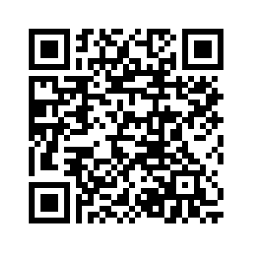
Mattermost (OpenETC) chat.opened.ca
Notes:
Mattermost is an open collaboration and messaging platform similar to Slack or Microsoft Teams. Hosted by the good folks at OpenETC (some of whom are here today) and free/open to all post-secondary educators in BC.
Sign up at chat.opened.ca (click on don’t have an account) or use the QR code here which will take you to the Mattermost sign up page.
Join the ETUG Team and then add yourself to the Privacy Channel.
We invite you to share your data privacy stories and start the discussion!

