Slide 1
Care in Crisis; A Crisis of Care
Dr. Brenna Clarke Gray
Coordinator, Educational Technologies
Thompson Rivers University
Twitter: @brennacgray // bgray@tru.ca

Slide 2
Territorial Acknowledgement
I join you today from my home near the Kamloops campus of Thompson Rivers University, which is located on the Tk’emlups te Secwepemc territory within the unceded traditional lands of Secwepemcúl’ecw (Secwepemc Nation). Learning – and caring – has taken place on these lands since time immemorial.
I invite you to share the territory from which you join our conversation today in the public chat.

Slide 3
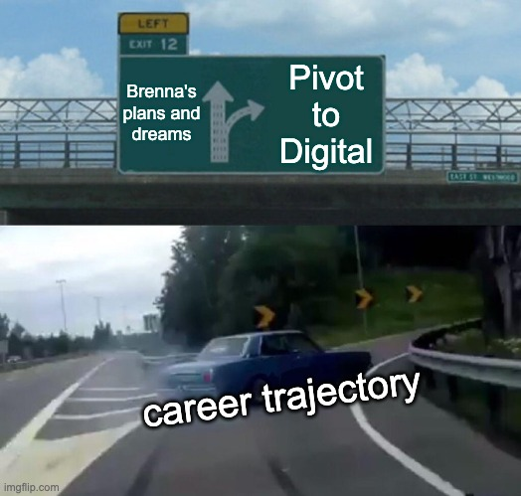
About Me
From 2010 – 2019, I was a community college instructor in English literature and academic writing.
In 2019, I came to Thompson Rivers University as Coordinator, Educational Technologies, with big plans to develop a research agenda on scholarly podcasting, open tenure processes, and ethical uses of EdTech.
Then, March 2020 happened.

Slide 4
About Our Contexts
Full-time campus support for learning technologies is three people, with additional supports (sometimes almost full-time!) of 2-3 additional staff, plus our director.
Supported additionally by instructional designers and teaching and learning centre.
Of our faculty complement of 500, ½ had never used digital tools, and ⅔ had not used them extensively.
By Fall, support ticket load 4 times higher than the previous year.

Slide 5
Care In Crisis
For our team, the foundation of our approach was rooted in care: simplify courses, scale back assessments and expectations, maximize instructor presence, and establish clear communication strategies.
We provided much of the guidance on these issues at the institution and worked to offer consistent guidance and messaging that centred care for students – and for instructors – first.
Our “Summer Camp” digital pedagogy training plan centered on building community and establishing care, both in the classroom and among participants.

Slide 6
Crisis In Care
But the numbers probably suggest to you a predictable story of burnout and overwork. So.
Throughout the pandemic period, our team absorbed a lot of panic, stress, and anxiety, because we were present and visible.
We also worked extremely long hours to manage the transition, and then to develop appropriate programming to support a most sustained virtual delivery model.
That work has continued, largely unabated, for nearly ten months. And the next semester is just around the corner.

Slide 7
Hi. I am *often* not okay. How are you?
Please share in the public chat, or feel free to unmute yourself.

Slide 8
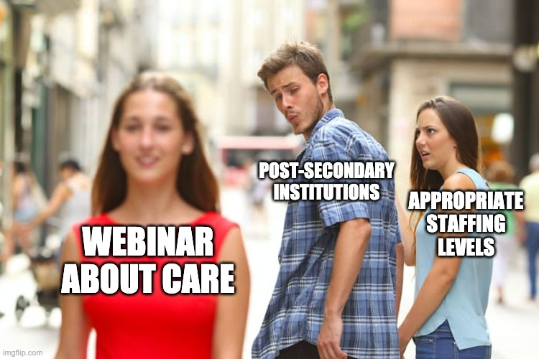

Slide 9
Educational Technology Support as Care Work
Through the pivot to digital, I came to see educational technology critically as care work. Care work is defined as labour undertaken in the immediate service of others, with assumptions made about motivation (intrinsic, not financial); it tends to be traditionally feminized labour.
Both teaching and faculty support have traditionally been seen as care work, where work in technology has not, perhaps because it has traditionally been a male-dominated field.
I believe we should be cautious of approaches to EdTech that are not rooted in care, that are not primarily operating in service of others and centering the needs of the most vulnerable members of our community.

Slide 10
Ethics of care
An ethics of care is based on four key elements:
Attentiveness: have we considered who is impacted by the choice and then listened to their needs and voice in relation to it?
Responsibility: do we have a reason to attend to this relationship?
Competence: can we follow through once we have heard from the people impacted?
Responsiveness: have we provided care that responds to the needs we are supposed to be attending to (ie. whose will are we truly serving)? And how can we demonstrate this?

Slide 11
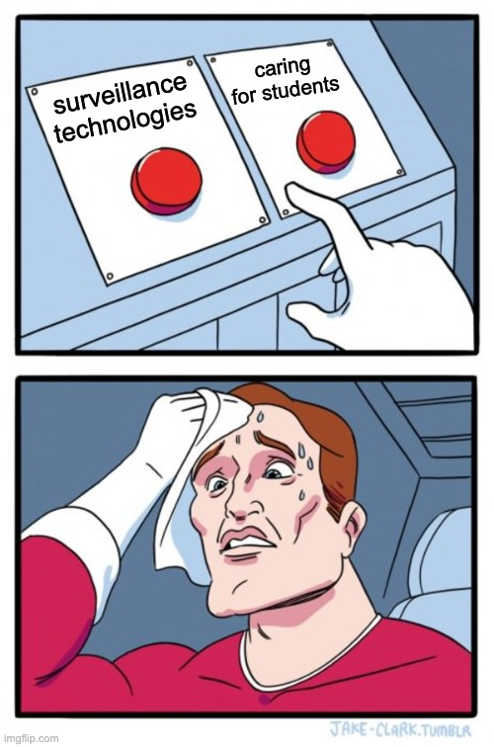
EdTech and Failed / Misapplied Care
It seems to me that often when we see the most egregious failings of educational technologies, we are seeing failures -- or misapplications – of care.
What would the work of sourcing new digital tools look like if we centred the ethics of care framework at every stage of selection and implementation? Would e-proctoring tools and homework systems – at least in their current iterations – ever see the light of day?

Slide 12
Whose Labour is Care?
We know that care work, like service work, within an institution is disproportionately undertaken by marginalized folks: Black, Indigenous, PoC, disabled, queer-identifying staff and faculty do the bulk of this work. This labour is also highly feminized.
When we devalue pastoral care, service, mentorship, etc., we are devaluing the work of already marginalized members of our community; likewise, when the burdens of care increase on campuses, they increase for these people first.

Slide 13
The Tricky Truth About Care
Care is strategically useful to the institution to cultivate on the micro level, between individuals; consider how much institutional marketing in the pandemic hinged on celebrating the efforts of individual instructors and their efforts.
If individuals are enacting care, the institution can remain relatively indifferent to necessary structural changes.
But care ultimately fails on the macro level when it isn’t supported by institutional structures (eg. an understaffed support unit).
Care cannot be extracted in perpetuity.

Slide 14
Moral Injury (or Moral Stress)
As I think through my experiences of the pandemic, and my relationship to the institution, I am increasingly interested in a moral-philosophical re-reading of the notion of a moral injury.
Moral injury is caused when we transgress our own personal morals or ethics in order to serve something/one else; originally conceptualized specifically as a wartime trauma, it has been applied to health care workers in the pandemic.
When our care is repurposed to prop up the very systems the ethics behind it would seek to strike down – when our care enables institutional inaction – is moral stress, if not injury, almost inevitable?

Slide 15
Hannah McGregor, in Hook & Eye: “What are we talking about when we talk about care”
“We might also ask: who does the burden of care fall on, and how might a depoliticized call for empathy be invisibilizing the very real inequities this crisis lays bare, particularly the urgency of the many forms of underpaid, precarious, and often gendered and racialized front-line work, and care work, that has been declared urgent and essential? Is our care being leveraged to ensure that the university maintains its institutional and imaginative force in the midst of this crisis, rather than being exposed as a site of neoliberal profiteering?”

Slide 16
Me, Responding in Hook & Eye: “Pedagogy of the So Stressed: Pivoting to Digital With an Ethic of Care”
“But this work of mine is still urgent. It is urgent because we have no evidence that the institution, left to its own devices, will enact an ethic of care without the individuals who take on the labour. And the people left in the wreckage are real people. So then what? I am really asking. Because until I figure it out, I am trapped between an intellectual awareness of my own exploitation (I can’t go on) and an emotional need to enact care on behalf of those who are owed it from an institution that cannot pay its debts (I’ll go on).”

Slide 17
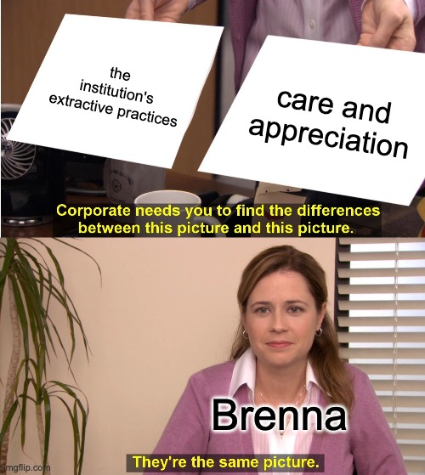
Hard Lessons

Slide 18
So what’s Next?: Or, Why I can’t Just Let It Break
Whether we serve faculty or students, support roles within institutions are in part controlled by a sense of obligation, and as our units are increasingly scaled back, there is less guarantee that someone else can pick up the slack.
Considering who that labour will be downloaded to, or who will slip through the cracks if it downloads to no one, can keep us trapped in a cycle that leads to burnout.
The situation is not dramatically different for classroom instructors, especially those with large teaching loads.

Slide 19
Moral Repair
Suzanne Shale posits several steps to achieving “moral repair,” but key among them is institutions taking responsibility for harm:
Acknowledging responsibility. Moral repair requires that those who are truly responsible for something acknowledge that responsibility. This is not the same as laying blame. In acknowledging responsibility, the person or institution recognises that others have placed reliance on them and have been let down. Acknowledging responsibility reinforces the view that the norms are valid, and it is reasonable to rely on them.
I wonder, often, if our relationship to the institution as a structure can allow for this kind of repair to take place.
What is the institution’s duty of care to the caretakers?

Slide 20
I have very few answers here, And my Faith is Slipping
Too often, we frame these issues as problems of the individual: set better boundaries; attend more mental health webinars.
But if moral stress is what we’re experiencing, moral repair requires an acknowledgement of the systemic pressures that cause the stress in the first place; our mental health relies not on personal best practices, but structural change.
Pressures and overwork right now are, sector-wide, leading to lapses in governance, disaster capitalist approaches to reorganizations and restructurings, and poor pedagogical choices.

Slide 21
It is not a personal failing if you are struggling right now
Our institutions cannot love us, but perhaps we can demand that they see us.

Slide 22
I’d love to hear your thoughts on how we move through this together
Please feel invited to unmute, or use the public chat, to join me in thinking about care, repair, and how we unravel it from here.

Slide 23
References
Maguen, S., & Price, M. A. (2020). Moral injury in the wake of coronavirus: Attending to the psychological impact of the pandemic. Psychological Trauma: Theory, Research, Practice, and Policy, 12(S1), S131-S132. 10.1037/tra0000780
Maio, G. (2018) Fundamentals of an Ethics of Care. In: Krause F., Boldt J. (eds) Care in Healthcare. Palgrave Macmillan, Cham. 10.1007/978-3-319-61291-1_4
Owens, L & Ennis, C. (2005). The Ethic of Care in Teaching: An Overview of Supportive Literature, Quest, 57:4, 392-425. 10.1080/00336297.2005.10491864
Pettersen, T. (2011). The ethics of care: normative structures and empirical implications. Health care analysis : HCA : journal of health philosophy and policy, 19(1), 51–64. 10.1007/s10728-010-0163-7
Shale S. (2020). Moral injury and the COVID-19 pandemic: reframing what it is, who it affects and how care leaders can manage it. BMJ Leader. 10.1136/leader-2020-000295
Social Sciences Feminist Network Research Interest Group. (2017). The Burden of Invisible Work in Academia: Social Inequalities and Time Use in Five University Departments. Humboldt Journal of Social Relations, 39, 228-245. http://www.jstor.org/stable/90007882

